Slide 1
setsid(), getpgrp(), getpgid(),
& setpgrp(), setpgid(), kill()

Slide 2
Introduction
In UNIX-like operating systems, a process group denotes a collection of one or more processes.
It is used to control distribution of a signal i.e. when a signal is directed to a process group, each member of the process group receives the signal.
Collection of processes associated with same job/terminal.
Each process group has a unique process group id.
Process group ids are positive integers and can be stored in pid_t data type.
Each process group can have a process group leader.
  Leader is identified by its pgid==pid
  Leader can create a new process group ,create processes in the group

Slide 3
Introduction
Sessions
Collection of one or more process groups.
If the calling process is not a process group leader,this function creates a new session. Three things happen:
  the process becomes the session leader of this new session.
  the process becomes the process group leader of a new process group.
  The process has no controlling terminal.

Slide 4
setsid()
Syntax
pid_t setsid(void)
Description
Creates a new session with the calling process as its session leader. The caller becomes the process group leader of a new process group. The calling process must not be a process group leader already. The caller does not have a controlling terminal.
The process groupid(pgid) of the new process group is equal to the process id(pid) of the caller. The caller starts as the only process in the new process group and in the new session.

Slide 5
setsid()
Returned value
    If successful, setsid() returns the value of the caller's new pgid.
    If unsuccessful, setsid() returns -1 and sets errno to indicate the error.
Occurrence of Errors
    The caller is already a process group leader.
    The caller's pid matches the pgid of some other process.

Slide 6
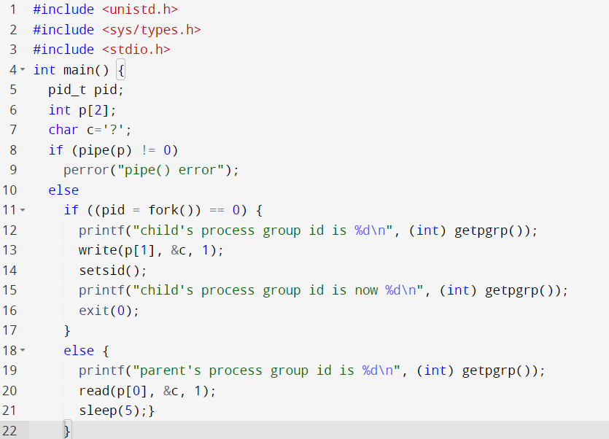
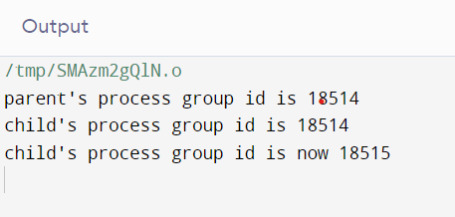
Example of setsid()
OUTPUT

Slide 7
getpgrp()
System call to get the process group ID
It is always successful
There are no documented errno values
Signature :-
pid.t getpgrp(void)
Parameter : No parameter
Return Value : returns the process group ID of the calling process
Error Values : No return value is preserved to indicate an error
Header Files : #include <unistd.h>

Slide 8
getpgrp() - Example to get all process group ids
#include <unistd.h>
#include <sys/wait.h>
#include <iostream>
#include <stdlib.h>
using namespace std;
int main() {
int status;
int pid = fork();
if (pid == 0) {
int cid = fork();
if (cid == 0) {
cout<<"grandchild's pid is : "<<getpid()<<" and process group id is : "<<getpgrp()<<endl;
exit(0);
}
cout<<"child's pid is : "<<getpid()<<" and process group id is : "<<getpgrp()<<endl;
wait(&status);
exit(0);
}
cout<<"parent's pid is : "<<getpid()<<" and process group id is : "<<getpgrp()<<endl;
cout<<"the parent's parent's pid is : "<<getppid()<<endl;
wait(&status);
}

Slide 9
getpgrp() - Example to get all process group ids
Output :-
parent's pid is : 68 and process group id is : 68
the parent's parent's pid is : 67
child's pid is : 72 and process group id is : 68
grandchild's pid is : 73 and process group id is : 68

Slide 10
getpgrp()
It is equivalent to :-
getpgid(pid = 0)
If pid = 0 in getpgid(), it returns the process group ID of the calling process.

Slide 11
getpgrp() = getpgid(0)
Example :-
#include <unistd.h>
#include <sys/wait.h>
#include <iostream>
#include <stdlib.h>
using namespace std;
int main() {
int status;
int pid = fork();
if (pid == 0) {
cout<<"\nChild process pid : "<<getpid()<<endl;
cout<<"Process group id using getpgrp() : "<<getpgrp()<<endl;
cout<<"Process group id using getpgid(0) : "<<getpgid(0)<<endl;
}
else{
wait(NULL);
cout<<"\n\nParent process pid : "<<getpid()<<endl;
cout<<"Process group id using getpgrp() : "<<getpgrp()<<endl;
cout<<"Process group id using getpgid(0) : "<<getpgid(0)<<endl;
}
return 0;
}
Output :-
Child process pid : 2456
Process group id using getpgrp() : 2452
Process group id using getpgid(0) : 2452
Parent process pid : 2452
Process group id using getpgrp() : 2452
Process group id using getpgid(0) : 2452

Slide 12
getpgid()
Syntax
pid_t getpgid( pid_t pid )
Description
The getpgid function returns the process group id of the process with process id equal to pid .
Value of 0 for the pid argument ( getpgid(0) ) return process group id of the calling process.
Which is equivalent to getpgrp() function.

Slide 13
getpgid()
Returned value
    If successful, returns a process group ID of process pid.
    If unsuccessful, It returns -1 and sets errno to indicate the error.
Occurrence of Errors
  One of the following error conditions exists:
    There is no process with a process ID equal to pid.
    The process pid is not in the same session as the calling process, and can’t access the process group ID of that process from the calling process.

Slide 14
Example of getpgid()
pgid = getpgid(pid); //pgid stores process group id of pid
if ( pgid == -1 ) {
//error ocurred
…}
else if ( pgid == getpgid(0) ) {
// pid is of same process group as calling process
…}
else{
//pid is of different process group to calling process
…}

Slide 15
setpgrp()
Signature :-
pid.t setpgrp(void)
Parameter : No parameter
Return Value : returns the new process group ID
Header Files : #include <sys/types.h>
#include <unistd.h>

Slide 16
setpgrp()
If the calling process is not already a session leader, setpgrp() sets the process group ID of the calling process to the process ID of the calling process.
If setpgrp() creates a new session, then the new session has no controlling terminal.
The setpgrp() function has no effect when the calling process is a session leader.
Upon completion, setpgrp() returns the process group ID.
No errors are defined.

Slide 17
setpgrp() - Example
Example :-
#include <unistd.h>
#include <sys/wait.h>
#include <iostream>
using namespace std;
int main() {
int status;
int pid = fork();
if (pid == 0) {
cout<<"\nChild process pid : "<<getpid()<<endl;
cout<<"Process group id using getpgrp() : "<<getpgrp()<<endl;
cout<<"Process group id after setpgrp() : "<<setpgrp()<<endl;
cout<<"Process group id using getpgrp() after setpgrp() : "<<getpgrp()<<endl;
}
else{
wait(NULL);
cout<<"\nParent process pid : "<<getpid()<<endl;
cout<<"Process group id using getpgrp() : "<<getpgrp()<<endl;
}
}
Output :-
Child process pid : 1253
Process group id using getpgrp() : 1249
Process group id after setpgrp() : 1253
Process group id using getpgrp() after setpgrp() : 1253
Parent process pid : 1249
Process group id using getpgrp() : 1249

Slide 18
setpgrp()
It is equivalent to :-
setpgid(pid = 0, pgid = 0)
If pid = 0 in getpgid(), the process ID of the calling process is used i.e. it means we have to set the pgid of the calling process.
If pgid = 0 in getpgid(), the process group id of the calling process is used i.e. the process specified by pid becomes a process group leader.

Slide 19
setpgrp() = setpgid(0,0)
Example :-
#include <unistd.h>
#include <sys/wait.h>
#include <iostream>
using namespace std;
int main() {
int status;
int pid = fork();
if (pid == 0) {
cout<<"\nChild process pid : "<<getpid()<<endl;
cout<<"Process group id using getpgrp() : "<<
getpgrp()<<endl;
cout<<"Process group id after setpgrp() : "
<<setpgrp()<<endl;
cout<<"Process group id using getpgrp()
after setpgrp() : "<<getpgrp()<<endl;
}else{
wait(NULL);
}
}
Output :-
Child process pid : 92
Process group id using getpgrp() : 88
Process group id after setpgrp() : 92
Process group id using getpgrp() after setpgrp() : 92
Example :-
#include <unistd.h>
#include <sys/wait.h>
#include <iostream>
using namespace std;
int main() {
int status;
int pid = fork();
if (pid == 0) {
cout<<"\nChild process pid : "<<getpid()<<endl;
cout<<"Process group id using getpgrp() : "<<getpgrp()<<endl;
cout<<"Process group id after setpgid(0,0) : "<<setpgid(0,0)<<endl;
cout<<"Process group id using getpgrp() after setpgid(0,0) : "<<getpgrp()<<endl;
}
else{
wait(NULL);
}
}
Output :-
Child process pid : 94
Process group id using getpgrp() : 90
Process group id after setpgid(0,0) : 0
Process group id using getpgrp() after setpgid(0,0) : 94

Slide 20
setpgid()
Syntax
int setpgid(pid_t pid,pid_t pgid)
Description
It is used either to join an existing process group or create a new process group within the session of the calling process.
pid_t pid is the process id(pid) of the process whose pgid you want to change. This must either be the caller of setpgid() or one of its children, and it must be in the caller's session. It cannot be the pid of a session leader. If pid is zero, the system uses the pid of the process calling setpgid().
setpgrp() is equivalent to setpgid(0,0).

Slide 21
setpgid()
pid_t pgid is the new pgid you want to assign to the process identified by pid. If pgid indicates an existing process group, it must be in the caller's session. If pgid is zero, the system uses the pid of the process indicated by pid as the id for the new process group. The new group is created in the caller's session.
Returned value
    If successful, setpgid() returns 0.
    If unsuccessful, setpgid() returns -1 and sets errno to indicate the error.
Occurrence of Errors
    pgid is less than zero or has some other unsupported value.
    pid does not match the pid of the calling process or any of its children.
    The caller cannot change the pgid of the specified process

Slide 22
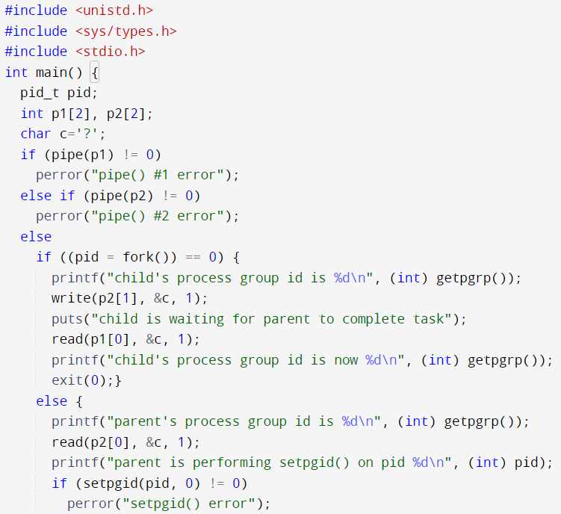
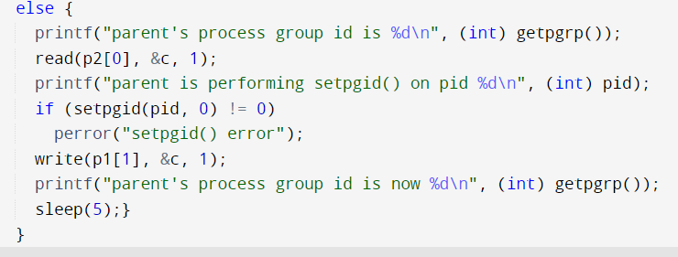
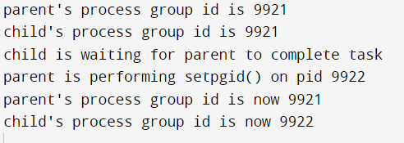
Example of setpgid()
OUTPUT

Slide 23
kill()
Signature :-
pid.t kill(pid.t pid, int sig)
Parameter : 2 parameters
pid = process id
sig = signal number of signal to be sent
Return Value : 0 if successful, -1 in case of error and sets errno
Error Values : return value is preserved to indicate an error
Header Files : #include <sys/types.h>
#include <signal.h>

Slide 24
kill()
The kill() function sends a signal to a process or a group of processes specified by the pid.
The signal to be sent is specified by sig and is either one from the list given in <signal.h> or 0.
If sig is 0 (the null signal), error checking is performed but no signal is actually sent. This can be used to check the validity of pid.
If pid is greater than 0, sig will be sent to the process whose process ID is equal to pid.
If pid is 0, sig will be sent to all processes whose process group ID is equal to the process group ID of the sender, and for which the process has permission to send a signal.
If pid is -1, sig will be sent to all processes for which the process has permission to send a signal.
If pid is negative but not −1, sig will be sent to all processes whose process group ID is equal to the absolute value of pid and for which the process has permission to send a signal.

Slide 25
kill()
Upon successful completion, 0 is returned.
Otherwise, −1 is returned, no signal is sent, and errno is set to indicate the error.
Errors : The kill() function will fail if:
EINVAL - The sig argument is not a valid signal number.
EPERM - The sig argument is SIGKILL and the pid argument is -1 (that is, the calling process does not have permission to send the signal to any of the processes specified by pid).
ESRCH - No process or process group can be found corresponding to that specified by pid.

Slide 26
kill() - Example (sig=0)
#include <unistd.h>
#include <sys/wait.h>
#include <iostream>
#include <signal.h>
using namespace std;
int main() {
int status;
int pid = fork();
cout<<"pid : "<<pid<<endl;
if (pid == 0) {
cout<<"\nChild process pid : "<<getpid()<<endl;
}else{
cout<<"Parent process pid : "<<getpid()<<endl;
cout<<"Executing kill(pid, 0) : "<<kill(pid, 0)<<endl;
cout<<"After kill"<<endl;
wait(&status);
if (WIFSIGNALED(status))
if (WTERMSIG(status) == SIGTERM)
cout<<"child was ended with a SIGTERM"<<endl;
else
cout<<"child was ended with a "<<WTERMSIG(status)<<" signal"<<endl;
else
cout<<"child was not ended with a signal"<<endl;
}
}
Output :-
pid : 22
Parent process pid : 18
Executing kill(pid, 0) : 0
After kill
pid : 0
Child process pid : 22
child was not ended with a signal
Note : WIFSIGNALED() method is used to check whether a process exited due to any signal i.e. whether the child process exited abnormally. It takes in process status code as returned by wait() or waitpid() and returns True if the process exited due to a signal, otherwise returns False.
WTERMSIG() method is used to get the signal number which caused the process to exit.

Slide 27
kill() - Example (pid>0)
#include <unistd.h>
#include <sys/wait.h>
#include <iostream>
#include <signal.h>
using namespace std;
int main() {
int status;
int pid = fork();
cout<<"pid : "<<pid<<endl;
if (pid == 0) {
cout<<"\nChild process pid : "<<getpid()<<endl;
}else{
cout<<"Parent process pid : "<<getpid()<<endl;
cout<<"Executing kill(pid, sig) : "<<kill(pid, SIGTERM)<<endl;
cout<<"After kill"<<endl;
wait(&status);
if (WIFSIGNALED(status))
if (WTERMSIG(status) == SIGTERM)
cout<<"child was ended with a SIGTERM"<<endl;
else
cout<<"child was ended with a "<<WTERMSIG(status)<<" signal"<<endl;
else
cout<<"child was not ended with a signal"<<endl;
}
}
Output :-
pid : 81
Parent process pid : 77
Executing kill(pid, sig) : 0
After kill
child was ended with a SIGTERM
Note : If instead of SIGTERM, SIGKILL signal was used, output is :-
pid : 82
Parent process pid : 78
Executing kill(pid, sig) : 0
After kill
child was ended with a 9 signal

Slide 28
kill() - Example (pid=0)
#include <unistd.h>
#include <sys/wait.h>
#include <iostream>
#include <signal.h>
using namespace std;
int main() {
int status;
int pid = fork();
cout<<"pid : "<<pid<<endl;
if(pid>0){
cout<<"Process group id of child : "<<getpgid(pid)<<endl;
}
if (pid == 0) {
cout<<"\nChild process pid : "<<getpid()<<endl;
}
else{
cout<<"Parent process pid : "<<getpid()<<endl;
cout<<"Parent process group id : "<<getpgrp()<<endl;
cout<<"Executing kill(0, sig) : "<<kill(0, SIGTERM)<<endl;
cout<<"After kill"<<endl;
wait(&status);
}
}
Output :-
pid : 1705
Process group id of child : 1701
Parent process pid : 1701
Parent process group id : 1701

